Slide 1
Training Management System
<number>

Slide 2
Training Management
Group 7-Team Members
16083 Abhinav Anand
16110 Lokesh Nehete
16170 Geetanjali Kulkarni
16170 Hemant Bhosale
16206 Subhashini Asthana
16210 Umesh Kumar Toke
<number>

Slide 3
Introduction –By Umesh Toke
<number>

Slide 4
Training Management
1) Angular JS – Client
2) Rest API – Using Spring MVC
3) Spring 4 Hibenate 5 – Back End
4) Maven Project
5) To Resolve Merge Conflict – GitHub.com
<number>

Slide 5
Resource File – By Hemant
<number>

Slide 6
Database Schema –By Geetanjali
<number>

Slide 7
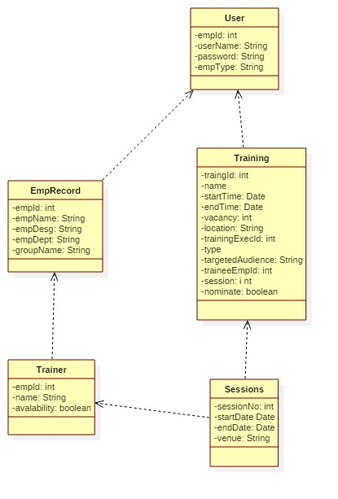
<number>

Slide 8
Login Module-By Abhinav Anand
<number>

Slide 9
Sessions and Cookies-Hemant
<number>

Slide 10
Register Training-By Umesh Toke
<number>

Slide 11
Delete Training-By Subhashini
<number>

Slide 12
Mandatory training-By Abhinav Anand
<number>

Slide 13
Future training-By Subhashini
<number>

Slide 14
Trainers training- By Lokesh Nehete
<number>

Slide 15
Logout-By Hemant
<number>

Slide 16
Thank You!
Notes:
<number>

